Slide 1
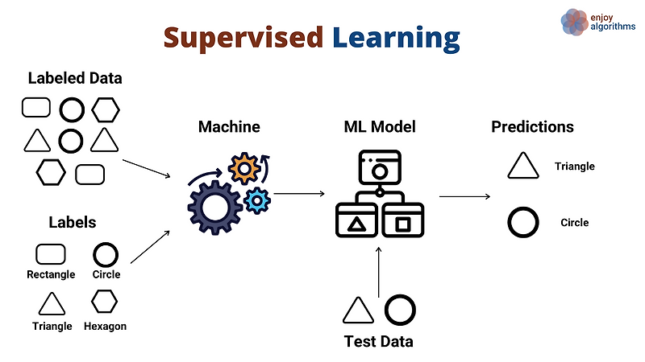
Supervised Learning
Unlocking the power of artificial intelligence through guided learning

Slide 2






What is Supervised Learning?
Machine Learning Paradigm
Learning with Guidance
Goal: Accurate Prediction
A supervised learning approach where algorithms learn patterns and relationships from labeled training data, building predictive models that can generalize to new situations.
Imagine having a knowledgeable teacher who provides the correct answers for every example. The algorithm learns by comparing its predictions to the known correct answers and adjusting accordingly.
The ultimate objective is to train a model that can accurately predict outputs for new, unseen data—applying what it learned during training to real-world scenarios.
Supervised learning represents one of the most fundamental and widely-used approaches in machine learning. It's called "supervised" because the process of an algorithm learning from the training dataset can be thought of as a teacher supervising the learning process. The correct answers (labels) are known, and the algorithm iteratively makes predictions on the training data and is corrected by the teacher (the labeled data). This learning process continues until the algorithm achieves a desired level of performance on the training data.

Slide 3
The Power of Labeled Data
Labeled data forms the foundation of supervised learning. It consists of input data paired with the corresponding correct output (often called the "ground truth"). This ground truth explicitly teaches the model the relationship between features and labels, enabling it to learn the underlying patterns.
The quality and quantity of labeled data directly determine how well the model will perform. More diverse, accurately labeled examples typically lead to better models that can generalize effectively to new situations.
What is Labeled Data?
Example: Image Classification
Input data (features) combined with the correct output (label or target). For example, an image of a cat labeled "cat" or a customer's information labeled "will purchase."
Thousands of images, each labeled as "cat," "dog," or "bird." The model learns to recognize visual patterns associated with each category.

Slide 4



How it Works: The Learning Process
Supervised learning follows a systematic process that transforms raw data into a functioning predictive model. Understanding each stage helps us build better machine learning systems.
Algorithm Choice
Model Training
Generalization
Selecting the right algorithm for the task at hand. Different algorithms work better for different types of data and problems.
Feeding labeled data to the algorithm, which adjusts its internal parameters to minimize prediction errors through iterative learning.
The trained model learns to apply its knowledge to new, unseen data, making accurate predictions on real-world scenarios.
During training, the algorithm makes predictions on the training data, compares those predictions to the actual known labels, and then adjusts its internal parameters to reduce the difference between predicted and actual values. This process repeats many times, gradually improving the model's accuracy. The key measure is how well the model performs on data it hasn't seen during training—this tests whether it truly learned the underlying patterns rather than just memorizing the training examples.

Slide 5
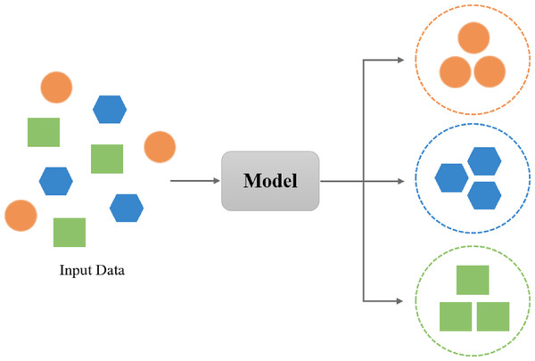
Key Challenge: Bias-Variance Tradeoff
One of the most fundamental challenges in supervised learning is finding the right balance between bias and variance. This tradeoff determines how well your model will perform on new data.
Understanding Bias
Bias represents systematic errors in prediction—when your model makes consistently wrong predictions. High bias means the model is too simple and doesn't capture important patterns in the data (underfitting). For example, trying to fit a straight line to curved data will always produce biased predictions.
Understanding Variance
Variance measures sensitivity to fluctuations in the training data. High variance means the model is too complex and captures noise along with real patterns (overfitting). Such a model performs excellently on training data but poorly on new data because it learned the noise specific to the training set rather than general patterns.
Finding the Sweet Spot
The ideal model balances low bias (accurate predictions) with low variance (consistent performance). Techniques like cross-validation, regularization, and proper model selection help find this balance. The goal is a model that captures the true underlying patterns without memorizing noise.

Slide 6
Type 2: Regression - Predicting Continuous Values
Regression is the other major type of supervised learning, focused on predicting continuous numerical values rather than discrete categories. While classification asks "which category?", regression asks "how much?" or "what value?"
Predicting House Prices
Forecasting Stock Prices
Estimating Sales Revenue
Estimates property values based on features like square footage, location, number of bedrooms, and neighborhood characteristics. Real estate platforms use regression models to provide instant price estimates.
Predicts future stock values based on historical price movements, trading volume, and market indicators. While never perfect, regression models help investors understand potential price movements.
Projects future sales based on marketing spend, seasonality, economic indicators, and historical performance. Businesses use these predictions for budgeting and planning.
Regression models output a continuous value rather than a category. The prediction might be a price, temperature, time, distance, or any measurable quantity. The model learns the relationship between input features and the continuous output variable, enabling it to interpolate and extrapolate based on new inputs.

Slide 7






Real-World Applications: Where We See It
Supervised learning powers countless applications that touch our daily lives, from healthcare to finance to entertainment. These real-world implementations demonstrate the practical value of this fundamental machine learning approach.
Healthcare: Medical Diagnosis
Finance: Risk Assessment
Diagnosing diseases from medical images with accuracy rivaling human experts. X-rays, MRIs, and CT scans are analyzed to detect tumors, fractures, pneumonia, and other conditions. Machine learning models can identify subtle patterns that even experienced radiologists might miss.
Assessing credit risk and predicting loan defaults by analyzing applicant information, credit history, and financial patterns. Banks use these models to make lending decisions, while credit card companies use them to detect fraudulent transactions in real-time.
E-commerce: Product Recommendations
Autonomous Vehicles: Object Detection
Recommending products based on user behavior, purchase history, and similar customers. Analyzing customer sentiment from reviews and social media to understand product reception and identify issues before they escalate.
Identifying pedestrians, vehicles, traffic signs, and obstacles in real-time. Self-driving cars rely on supervised learning to navigate safely, processing camera, radar, and lidar data to make split-second decisions.
Natural Language Processing
Security: Facial Recognition
Understanding and translating human language. Voice assistants, chatbots, and translation services all use supervised learning to convert speech to text, understand intent, and generate appropriate responses.
Identifying individuals from images and video footage. Used for unlocking phones, airport security, finding missing persons, and monitoring public spaces. These systems learn to recognize unique facial features from thousands of labeled examples.

Slide 8
The Importance of Data Quality
"Your output is only as good as your input."
This adage holds especially true for supervised learning. The quality of your labeled training data fundamentally determines how well your model will perform. Garbage in, garbage out—no amount of sophisticated algorithm tuning can fix poor-quality training data.
Accurate Labels
Relevant Features
Diverse Examples
Every training example must have the correct label. Inaccurate labels teach the model wrong patterns, leading to poor predictions. Quality control during data labeling is essential.
The input data must contain features that actually relate to the output you're trying to predict. Irrelevant features add noise and can degrade model performance.
The training data should represent the full range of situations the model will encounter. Biased or narrow training data leads to models that fail on edge cases.
Creating high-quality labeled datasets is often the most time-consuming and expensive part of supervised learning projects. Data scientists spend considerable effort collecting, cleaning, and labeling data before any model training begins. This process might involve hiring domain experts to label complex data, implementing automated quality checks, or using active learning strategies that prioritize the most informative examples for labeling.
Even with perfect data, model performance depends on appropriate algorithm selection, hyperparameter tuning, and validation strategies. But without quality data, even the most sophisticated models will fail to deliver useful predictions.

